Slide 1
DataShop Hands On
http://pslcdatashop.org
Friday, December 10, 2010
PSLC DataShop
datashop-help@lists.andrew.cmu.edu
pslcdatashop.org

Slide 2
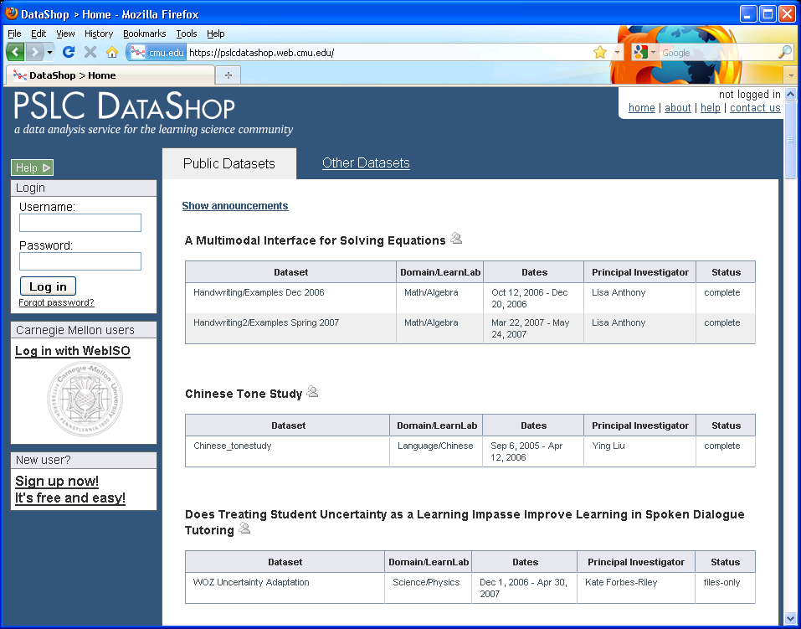
Notes:
CHECK POINT: Make sure all the participants are on this page.

Slide 3
Creating an account and Logging in
Getting Started
PSLC DataShop
datashop-help@lists.andrew.cmu.edu
pslcdatashop.org

Slide 4
If you are NOT a Carnegie Mellon University student, staff, or faculty member, and have logged in before
If you are a Carnegie Mellon University student, staff, or faculty member
If you are NOT a Carnegie Mellon University student, staff, or faculty member, and have NOT logged in before
PSLC DataShop
datashop-help@lists.andrew.cmu.edu
pslcdatashop.org

Slide 5
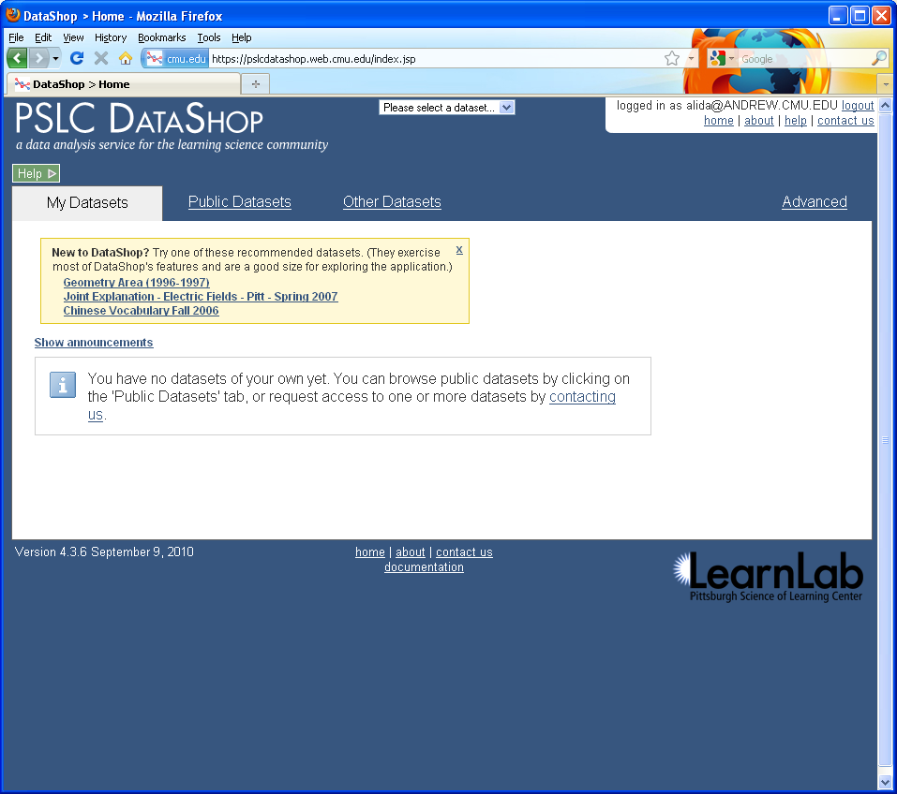
Introduction to PSLC DataShop
December 2010
Notes:
CHECK POINT: Make sure all the participants are on this page.

Slide 6
2
1
There are 3 places to click to get help on how to use DataShop!
3
Introduction to PSLC DataShop
December 2010
Notes:
CHECK POINT: Make sure all the participants are on this page.

Slide 7
1
Click the green help button to get help on the page you are currently on.
PSLC DataShop
datashop-help@lists.andrew.cmu.edu
pslcdatashop.org

Slide 8
Introduction to PSLC DataShop
December 2010

Slide 9
Click on
‘Documentation Home’ to get more information on this topic in our help pages.
PSLC DataShop
datashop-help@lists.andrew.cmu.edu
pslcdatashop.org

Slide 10
Click ‘about’ to see the latest news about DataShop and to get downloads
Click ‘contact us’ to send us email.
2
Click ‘home’ to get back to a list of projects and datasets in DataShop
Click ‘help’ here to go to the help page for the current report.
PSLC DataShop
datashop-help@lists.andrew.cmu.edu
pslcdatashop.org

Slide 11
3
Click ‘documentation’ at the bottom of any page to go to the help pages.
PSLC DataShop
datashop-help@lists.andrew.cmu.edu
pslcdatashop.org

Slide 12
Introduction to PSLC DataShop
December 2010
Notes:
This is our project page where we post news. Its also where you can download the logging library tools, the validation tools, and other downloads.

Slide 13
My Datasets: datasets you can use
Public Datasets: datasets you or anyone can use
Other Datasets: private datasets, you can ask us for access and we’ll confirm with the PI
Recommended Datasets: let’s start with Geometry Area
PSLC DataShop
datashop-help@lists.andrew.cmu.edu
pslcdatashop.org

Slide 14
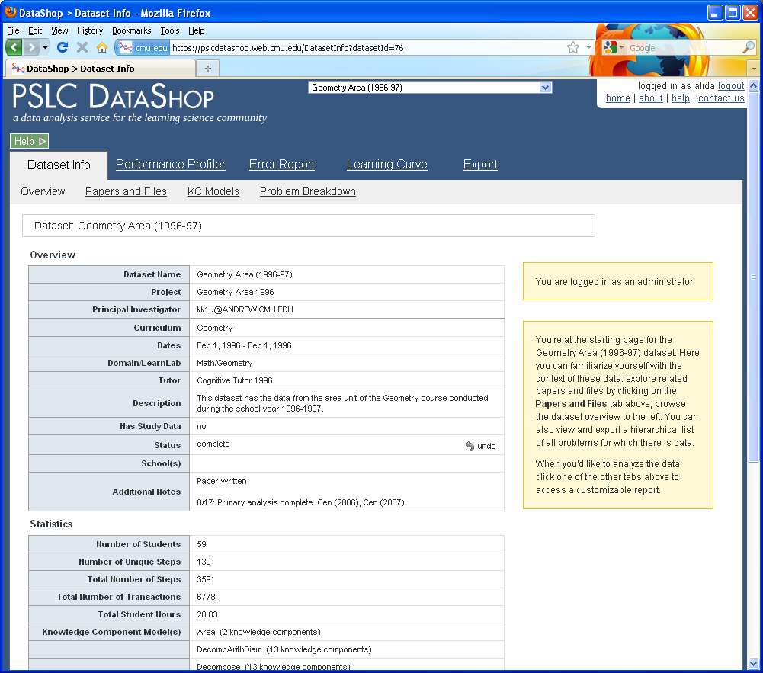
Introduction to PSLC DataShop
December 2010
Notes:
CHECK POINT: Make sure all the participants are on this page.

Slide 15
Pre & Post test data
Connection to the Theory Wiki
Example project page:
http://www.learnlab.org/research/wiki/index.php/Hausmann_Study
PSLC DataShop
datashop-help@lists.andrew.cmu.edu
pslcdatashop.org

Slide 16
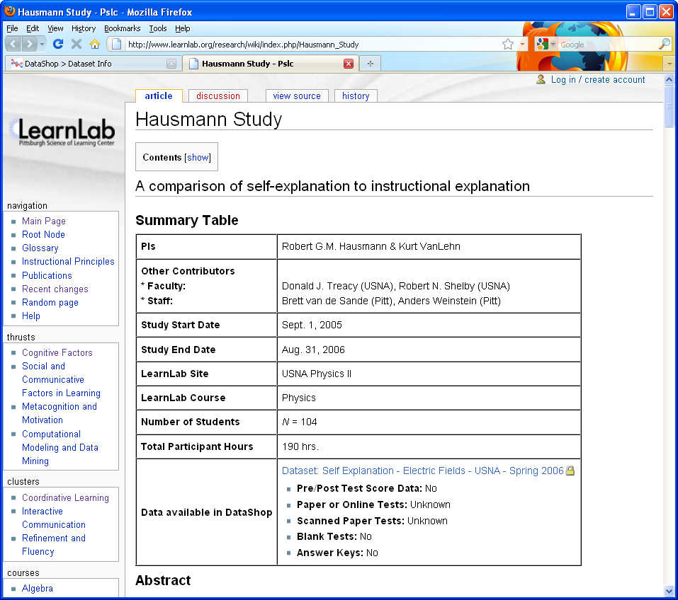
Introduction to PSLC DataShop
December 2010

Slide 17
On your project page in the Theory Wiki,
add a link to the dataset in DataShop.
In DataShop, attach files associated with pre and post test data to the appropriate dataset, and then update your project page.
PSLC DataShop
datashop-help@lists.andrew.cmu.edu
pslcdatashop.org

Slide 18
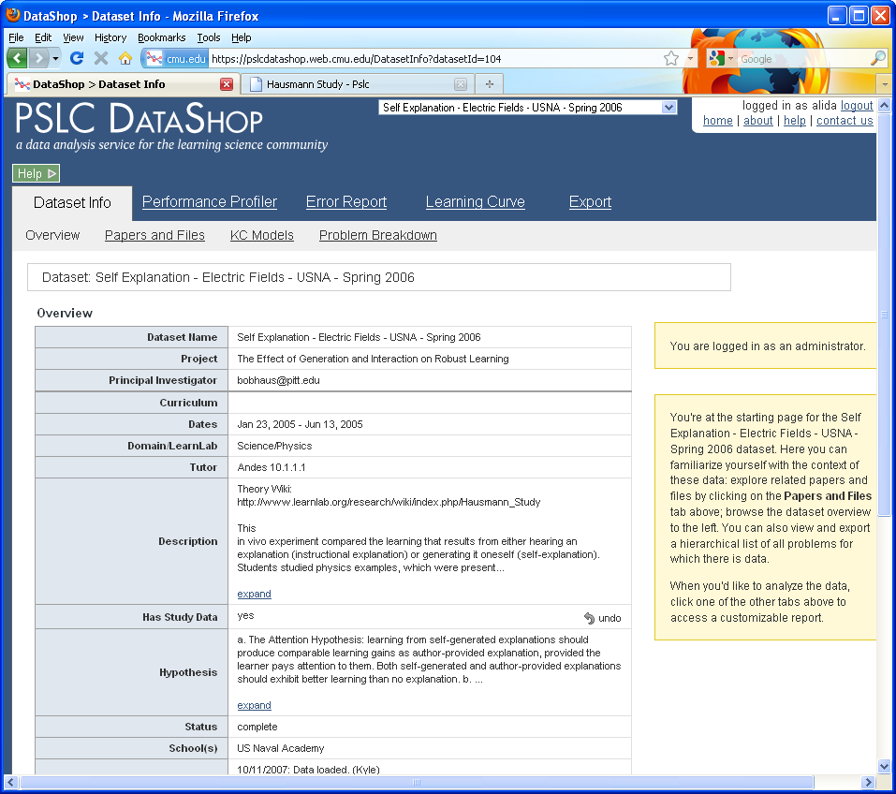
Introduction to PSLC DataShop
December 2010

Slide 19
In the Description for the dataset, add a link to your project page in the Theory Wiki.
Put a brief description of the dataset here, as the full description will be on your project page in the Theory Wiki.
PSLC DataShop
datashop-help@lists.andrew.cmu.edu
pslcdatashop.org

Slide 20
PSLC DataShop
datashop-help@lists.andrew.cmu.edu
pslcdatashop.org
Notes:
Here is some meta data about a dataset. If you are the PI you should update this information and keep it up to date.

Slide 21
PSLC DataShop
datashop-help@lists.andrew.cmu.edu
pslcdatashop.org
Notes:
This table gives you a sense of the size of the dataset. For example this dataset is fairly small with just 7 thousand transactions. These numbers all come from the data itself. The total student hours is a sum of the duration for each transaction. But to really understand this table, we are going to talk through some terminology.

Slide 22
Terminology
Getting Started
PSLC DataShop
datashop-help@lists.andrew.cmu.edu
pslcdatashop.org

Slide 23
DataShop Terminology
Problem: a task for a student to perform that typically involves multiple steps
Step: an observable part of the solution to a problem
Transaction: an interaction between the student and the tutoring system.
PSLC DataShop
datashop-help@lists.andrew.cmu.edu
pslcdatashop.org

Slide 24
DataShop Terminology
KC: Knowledge component
also known as a skill/concept/fact
a piece of information that can be used to accomplish tasks
KC Model:
also known as a cognitive model or skill model
a mapping between correct steps and knowledge components
PSLC DataShop
datashop-help@lists.andrew.cmu.edu
pslcdatashop.org

Slide 25
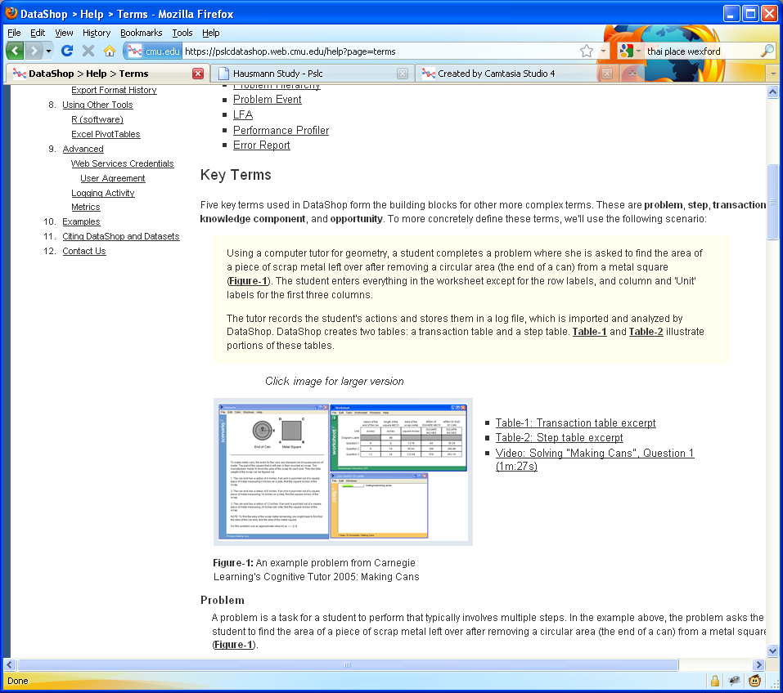
We use the “Making Cans” problem from the Cognitive Tutor as an example to explain the key terms used in DataShop
Watch this video to see how this tutor works

Slide 26
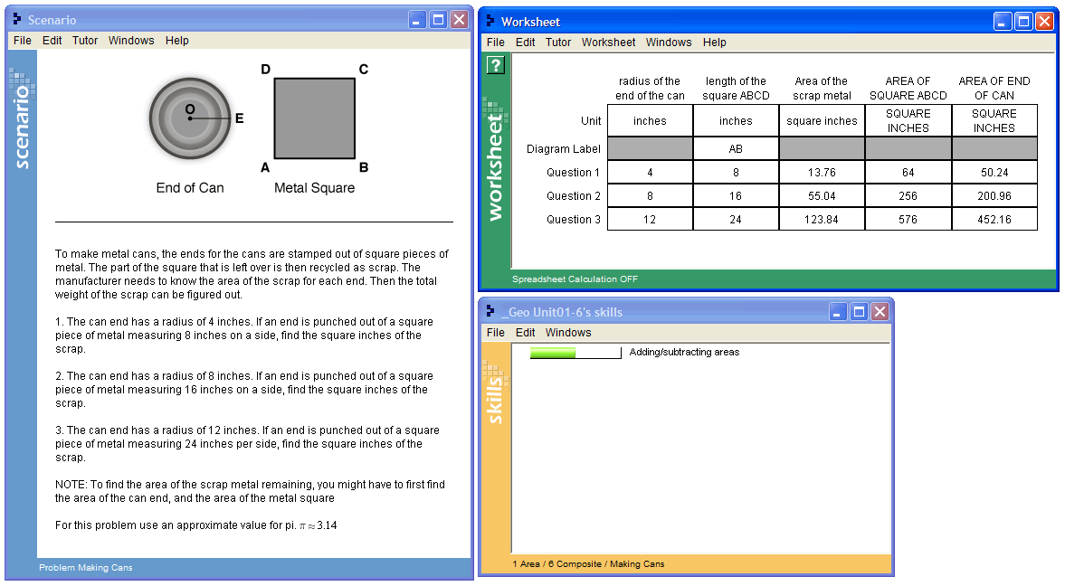
Problem: “Making Cans”
PSLC DataShop
datashop-help@lists.andrew.cmu.edu
pslcdatashop.org

Slide 27
Video: Solving “Making Cans”, Question 1 (1m:27s)
http://pslcdatashop.org/videos/making_cans/making_cans.jsp
PSLC DataShop
datashop-help@lists.andrew.cmu.edu
pslcdatashop.org

Slide 28
Steps
SCRAP-METAL-AREA Q1
SQUARE-BASE Q1
SQUARE-AREA Q1
POG-RADIUS Q1
POG-AREA Q1
PSLC DataShop
datashop-help@lists.andrew.cmu.edu
pslcdatashop.org

Slide 29
Transactions
Row | Student | Problem | Step | Attempt | Input | Evaluation | KC
9 | S01 | MAKING-CANS | (POG-RADIUS Q1) | 1 | 4 | CORRECT | Enter-Given
10 | S01 | MAKING-CANS | (SQUARE-BASE Q1) | 1 | 8 | CORRECT | Enter-Given
11 | S01 | MAKING-CANS | (SCRAP-METAL-AREA Q1) | 1 | 32 | INCORRECT
12 | S01 | MAKING-CANS | (SCRAP-METAL-AREA Q1) | 2 | 4 | INCORRECT
13 | S01 | MAKING-CANS | (SQUARE-AREA Q1) | 1 | 64 | CORRECT | Square-Area
14 | S01 | MAKING-CANS | (POG-AREA Q1) | 1 | 50.24 | CORRECT | Circle-Area
15 | S01 | MAKING-CANS | (SCRAP-METAL-AREA Q1) | 3 | 13.76 | CORRECT | Compose-Areas
PSLC DataShop
datashop-help@lists.andrew.cmu.edu
pslcdatashop.org
Notes:
Define KC and KC Model.

Slide 30
Student-Steps
Row | Student | Problem | Step | Opportunity | Total Incorrects | Total Hints | Assistance Score | Error Rate | KC
6 | S01 | MAKING-CANS | (POG-RADIUS Q1) | 2 | 0 | 0 | 0 | 0 | Enter-Given
7 | S01 | MAKING-CANS | (SQUARE-BASE Q1) | 3 | 0 | 0 | 0 | 0 | Enter-Given
8 | S01 | MAKING-CANS | (SQUARE-AREA Q1) | 1 | 0 | 0 | 0 | 0 | Square-Area
9 | S01 | MAKING-CANS | (POG-AREA Q1) | 2 | 0 | 0 | 0 | 0 | Circle-Area
10 | S01 | MAKING-CANS | (SCRAP-METAL-AREA Q1) | 2 | 2 | 0 | 2 | 1 | Compose-Areas
PSLC DataShop
datashop-help@lists.andrew.cmu.edu
pslcdatashop.org
Notes:
Opportunity relative to KC. A chance for a student to demonstrate that he or she has learned a KC.

Slide 31
Opportunity: a chance for a student to demonstrate that he or she has learned a KC.
Row | Student | Problem | Step | Opportunity | Total Incorrects | Total Hints | Assistance Score | Error Rate | KC
6 | S01 | MAKING-CANS | (POG-RADIUS Q1) | 2 | 0 | 0 | 0 | 0 | Enter-Given
7 | S01 | MAKING-CANS | (SQUARE-BASE Q1) | 3 | 0 | 0 | 0 | 0 | Enter-Given
8 | S01 | MAKING-CANS | (SQUARE-AREA Q1) | 1 | 0 | 0 | 0 | 0 | Square-Area
9 | S01 | MAKING-CANS | (POG-AREA Q1) | 2 | 0 | 0 | 0 | 0 | Circle-Area
10 | S01 | MAKING-CANS | (SCRAP-METAL-AREA Q1) | 2 | 2 | 0 | 2 | 1 | Compose-Areas
PSLC DataShop
datashop-help@lists.andrew.cmu.edu
pslcdatashop.org
Notes:
Opportunity relative to KC. Increases with steps, not with transactions.

Slide 32
Observation: set of transactions for a student working on a step, i.e. each row in this table
Row | Student | Problem | Step | Opportunity | Total Incorrects | Total Hints | Assistance Score | Error Rate | KC
6 | S01 | MAKING-CANS | (POG-RADIUS Q1) | 2 | 0 | 0 | 0 | 0 | Enter-Given
7 | S01 | MAKING-CANS | (SQUARE-BASE Q1) | 3 | 0 | 0 | 0 | 0 | Enter-Given
8 | S01 | MAKING-CANS | (SQUARE-AREA Q1) | 1 | 0 | 0 | 0 | 0 | Square-Area
9 | S01 | MAKING-CANS | (POG-AREA Q1) | 2 | 0 | 0 | 0 | 0 | Circle-Area
10 | S01 | MAKING-CANS | (SCRAP-METAL-AREA Q1) | 2 | 2 | 0 | 2 | 1 | Compose-Areas
PSLC DataShop
datashop-help@lists.andrew.cmu.edu
pslcdatashop.org
Notes:
Each row is an observation

Slide 33
The DataShop Tools
Learning Curve
Sample Selector
Error Report
Performance Profiler
Export
Import
PSLC DataShop
datashop-help@lists.andrew.cmu.edu
pslcdatashop.org

Slide 34
Learning curve
The Tools
How can I visualize student performance over time?
PSLC DataShop
datashop-help@lists.andrew.cmu.edu
pslcdatashop.org

Slide 35
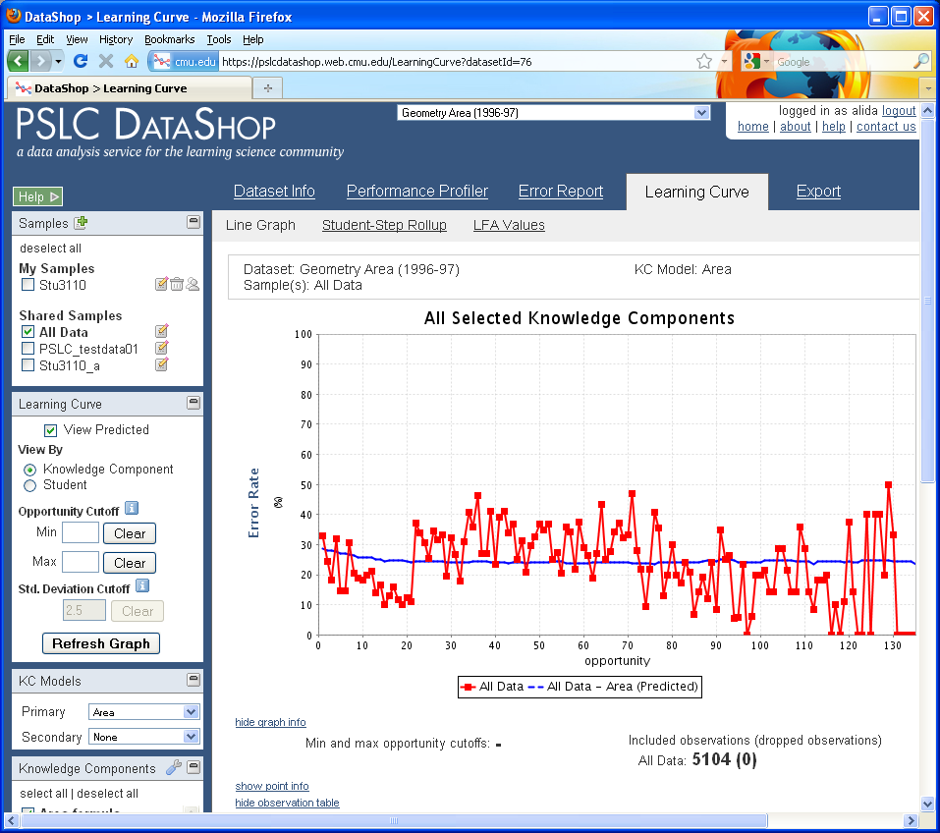

Slide 36
Visualizes changes in student performance over time
Hover the y-axis to change the type of Learning Curve.
Types include:
Error Rate
Assistance Score
Number of Incorrects
Number of Hints
Step Duration
Correct Step Duration
Error Step Duration
Time is represented on the x-axis as ‘opportunity’, or the # of times a student (or students) had an opportunity to demonstrate a KC
PSLC DataShop
datashop-help@lists.andrew.cmu.edu
pslcdatashop.org

Slide 37
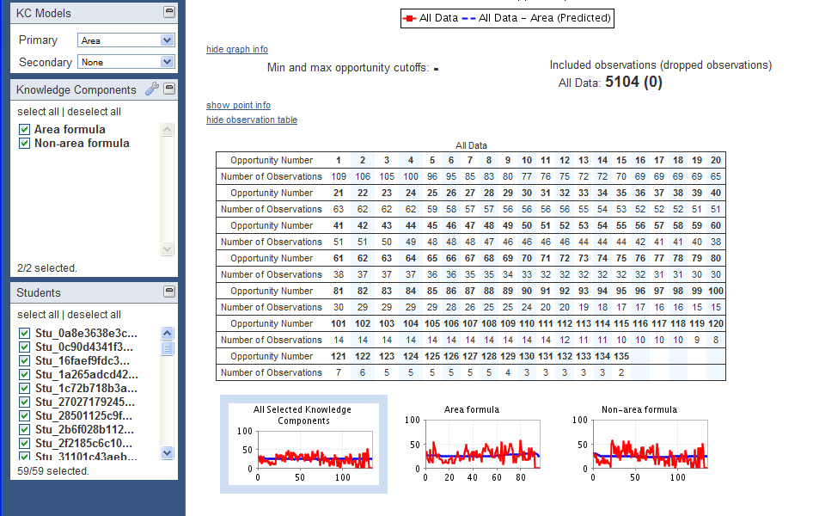
PSLC DataShop
datashop-help@lists.andrew.cmu.edu
pslcdatashop.org
Notes:
Two KCs, lots of practice. Doesn’t show learning of “area formula” or “non-area formula”. This is to say that either a step uses a “Area formula” knowledge component or it uses a “Non-area formula” knowledge component.

Slide 38
PSLC DataShop
datashop-help@lists.andrew.cmu.edu
pslcdatashop.org

Slide 39
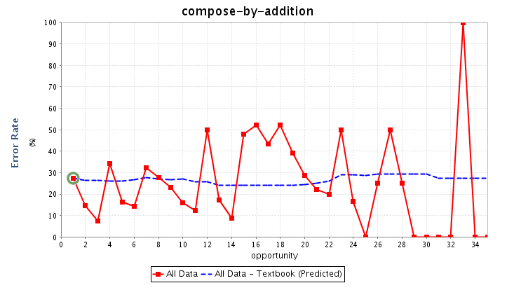
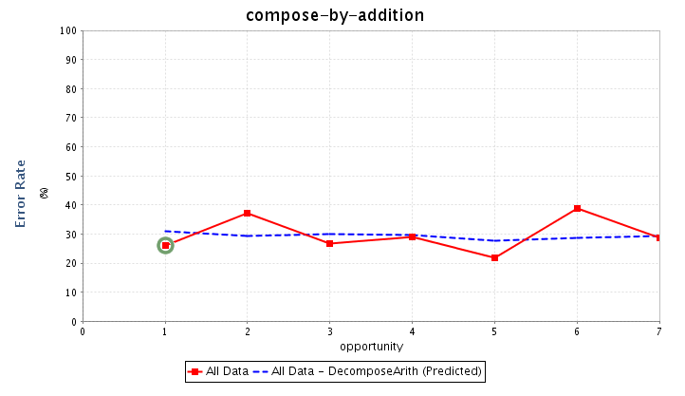
PSLC DataShop
datashop-help@lists.andrew.cmu.edu
pslcdatashop.org
Notes:
Plenty examples of not smooth curves. In this particular dataset, work was done to analyze the user interface of the tutor and the data, and come up with a different KC model. So, why is this useful? Why care whether you can make smoother curves?

Slide 40
If you change the KC model,
you should consider changing instruction
Problem creation, selection, and sequencing
New skills or concepts (new KCs) require:
New kinds problems & instructional activities
Changes to student modeling – skillometer, knowledge tracing
Feedback and hint message content
One KC becomes two => need new hint messages for new KC
New error feedback may be needed
Even interface design – “make thinking visible”
If multiple KC per step => break down by adding new intermediate steps to interface
PSLC DataShop
datashop-help@lists.andrew.cmu.edu
pslcdatashop.org
Notes:
Can’t do this IN DataShop, but worth considering the implications.

Slide 41
If interested in KC modeling …
Related tools
Model Values (Learning Curve > Model Values)
KC Models (Dataset Info > KC Models)
… but most tools in DataShop benefit from having a reasonable KC model.
PSLC DataShop
datashop-help@lists.andrew.cmu.edu
pslcdatashop.org

Slide 42
Hands on!
Decompose model
Which curves show learning? Which don’t?
Why?
PSLC DataShop
datashop-help@lists.andrew.cmu.edu
pslcdatashop.org
Notes:
See opportunity counts

Slide 43
Sample selector
The Tools
PSLC DataShop
datashop-help@lists.andrew.cmu.edu
pslcdatashop.org

Slide 44
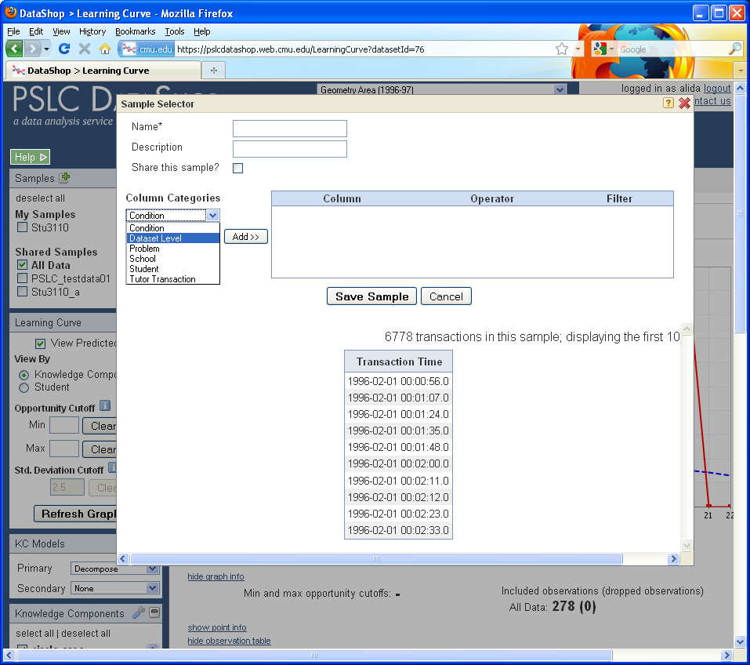

Slide 45
Sample Selector
Not samples in the statistical sense—these are subsets of data
You can make your own
e.g., filter on condition if that’s encoded in the data
You can switch between them, or show more than one sample
Notes:
e.g., on learning curve shows line per sample.

Slide 46
Performance profiler
The Tools
What was the hardest problem for students? How many students worked in a particular unit?
PSLC DataShop
datashop-help@lists.andrew.cmu.edu
pslcdatashop.org

Slide 47
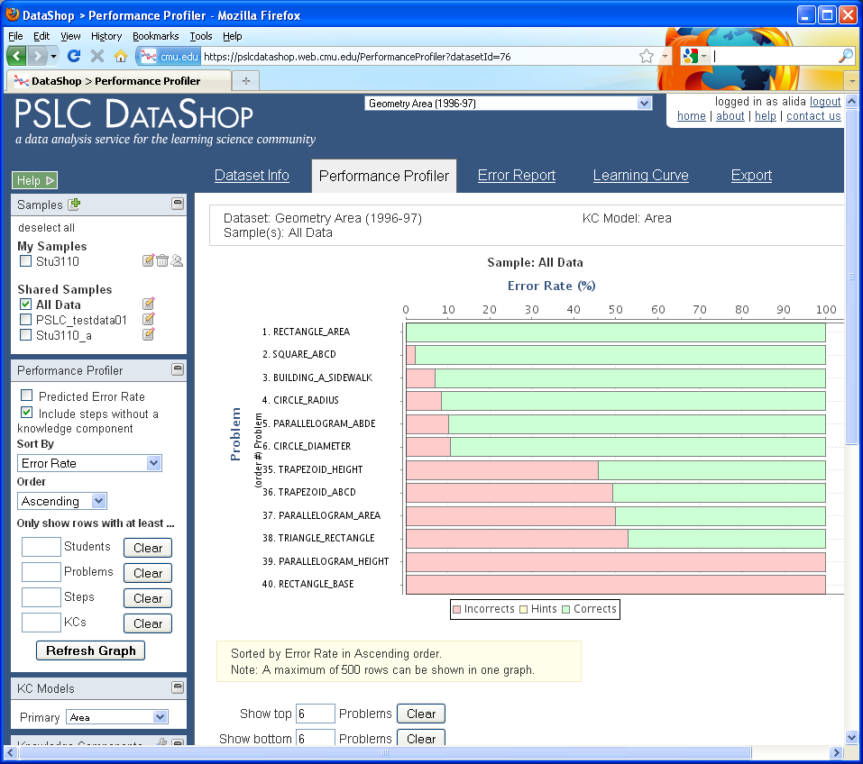

Slide 48
Change the settings for this tool using the options on the left hand side of the page
Change the sort order here
Set a minimum number of students to filter out problems not seen by many students
PSLC DataShop
datashop-help@lists.andrew.cmu.edu
pslcdatashop.org

Slide 49
Change how the selected measure is aggregated by hovering the title for the x-axis.
Change the selected measure by hovering the title for the y-axis.
See more details by hovering a bar in the graph.
PSLC DataShop
datashop-help@lists.andrew.cmu.edu
pslcdatashop.org

Slide 50
Find the hardest problem or KC
Hands on!
PSLC DataShop
datashop-help@lists.andrew.cmu.edu
pslcdatashop.org
Notes:
So let’s find the hardest problem. The hint here is that its not the bottom row that we are showing you here. You have to use the interface a little bit to change the graph.

Slide 51
Error report
The Tools
How can I explore the errors students made and drill down to see actual responses and feedback?
PSLC DataShop
datashop-help@lists.andrew.cmu.edu
pslcdatashop.org

Slide 52
Hands on!
Switch dataset to …
IWT Self-Explanation Study 0 (pilot) (Fall 2008)
PSLC DataShop
datashop-help@lists.andrew.cmu.edu
pslcdatashop.org

Slide 53
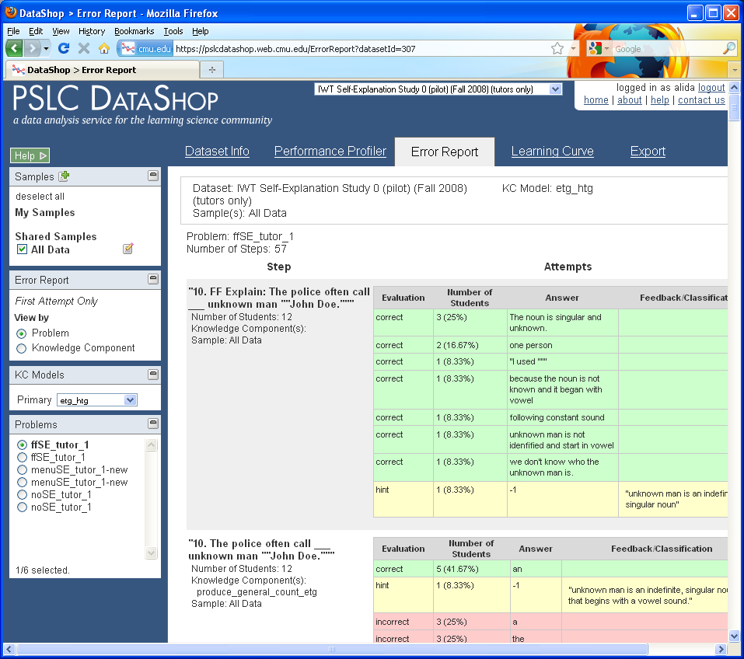
Notes:
Switch to IWT Self-Explanation Study 0 (pilot) (Fall 2008)

Slide 54
Change the settings for this tool using the options on the left hand side of the page
PSLC DataShop
datashop-help@lists.andrew.cmu.edu
pslcdatashop.org

Slide 55
The number of observations by type (correct, hint, or incorrect)
Details what the student actual typed into the tutor
PSLC DataShop
datashop-help@lists.andrew.cmu.edu
pslcdatashop.org
Notes:
Find a common error in English article usage

Slide 56
Hands on!
Find a common error in English article usage
PSLC DataShop
datashop-help@lists.andrew.cmu.edu
pslcdatashop.org

Slide 57
Export
The Tools
How do I get my data out of DataShop?
PSLC DataShop
datashop-help@lists.andrew.cmu.edu
pslcdatashop.org

Slide 58
3 data formats for exporting
Transaction
Export > By Transaction.
Data at the finest level of granularity possible—the level at which it was logged.
Student-Step
Export > By Student-Step.
Data aggregated by student-step: each row represents a student attempting to complete a step.
Student-Problem
Export > By Student-Problem.
Data aggregated by student and problem, describing unique problems students have engaged in.
PSLC DataShop
datashop-help@lists.andrew.cmu.edu
pslcdatashop.org
Notes:
There are three ways to get data out of DataShop. At the finest level of granularity, which is by transaction, or rolled up by student or by problem. You can see the columns on the reference sheet we handed out. Maybe the primary tool you use is Excel or SPSS. You can get your data out of DataShop to use the data in these tools. If you use Excel, be aware that Excel tends to automatically format the date/time fields for you resulting in data loss.

Slide 59
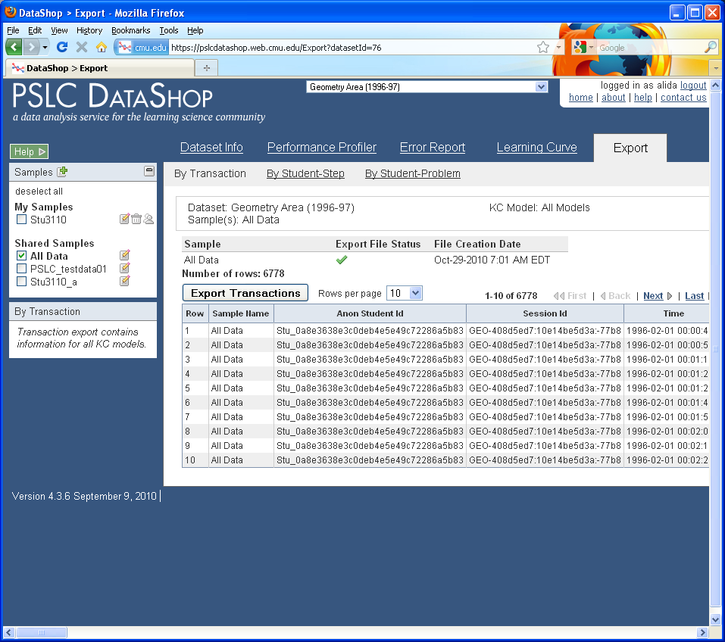

Slide 60
Look for the green check to see if that sample can be exported quickly
PSLC DataShop
datashop-help@lists.andrew.cmu.edu
pslcdatashop.org
Notes:
Be aware that on the transaction export, we try to cache the file ahead of time so that the export is fast. Look at this table to see the status for the sample or samples you are exporting. This does not apply to the student-step and student-problem rollups.

Slide 61
IMPORT
The Tools
How do I get my data into DataShop?
PSLC DataShop
datashop-help@lists.andrew.cmu.edu
pslcdatashop.org

Slide 62
How do I get data in?
Directly/Real-time
Some tutors are logging directly to the PSLC logging database
CTAT-based tutors (when configured correctly), can log to disk or to the logging database over the internet
Indirectly
Other tutors are logging to their own file formats or their own databases
These data require a conversion process
Many studies are in this category
PSLC DataShop
datashop-help@lists.andrew.cmu.edu
pslcdatashop.org
Notes:
Directly refers to real-time logging of data. In this situation, a tutor that is instrumented to log to DataShop sends its data over the web to a logging database. With a system like CTAT, this capability is built in.
Indirect logging—you might be storing data in your own format on your own hard disk or server. In this case, you’d need to consider how to convert your data from your format to DataShop’s.

Slide 63
XML vs. Tab-delimited format
XML
Richer description than tab-delimited
More fields
Problem start time
Problem description
Problem tutor flag
More verbose
Requires some familiarity with XML
Not especially readable
Tab-delimited
More concise
Can edit in Excel
More easily shareable
Less rich than XML
Missing problem start time, description, and tutor flag
PSLC DataShop
datashop-help@lists.andrew.cmu.edu
pslcdatashop.org
Notes:
DataShop has two similar formats, XML and tab-delimited. Tab-delimited is tabular, like an Excel spreadsheet. XML, if you’re not familiar, is like HTML; it’s a way of marking up, or describing, text; except with XML, those descriptions correspond to our format.
So how do they differ? Tab-delimited is generally simpler; why not just choose that format?
XML is richer. You have access to more fields, one of the most important being “problem start time”—you can say exactly when something was presented to a student or user. If you’re doing any type of latency-based analysis, this information might be crucial. Right now, it’s only available in the XML format.
XML, however, is more verbose—more lines of text to describe roughly the same thing—and its usually generated by a program.
Why tab-delimited? It’s more concise, editable in Excel, more human-readable. But it’s less rich.

Slide 64
Documentation
For XML:
Guide to the Tutor Message Format: http://pslcdatashop.org/dtd/guide/
For tab-delimited format:
http://pslcdatashop.org/about/importverify.html
To learn about terminology:
http://pslcdatashop.org/help?page=terms
To learn about existing DataShop output formats:
http://pslcdatashop.org/help?page=export
PSLC DataShop
datashop-help@lists.andrew.cmu.edu
pslcdatashop.org
Notes:
Here are some documentation pointers. I won’t say more about this; this information is in your copy of the slides.

Slide 65
Web services
The Tools
How can I programmatically retrieve data from DataShop?
PSLC DataShop
datashop-help@lists.andrew.cmu.edu
pslcdatashop.org

Slide 66
Web Services
Enable your program or web site to retrieve DataShop data
teacher reports
data mining
other analysis through code
PSLC DataShop
datashop-help@lists.andrew.cmu.edu
pslcdatashop.org
Notes:
Are you developing a program or web application that could benefit from retrieving DataShop data? Some examples might be teacher reports, data mining or analysis through a programming language… this is an advanced feature that we wanted to mention for future reference.

Slide 67
the end

Slide 68
Dataset Info
The Tools
PSLC DataShop
datashop-help@lists.andrew.cmu.edu
pslcdatashop.org

Slide 69
Go to the ‘Papers and Files’ subtab to download or attach papers and files to the given dataset.
Go to the ‘KC Models’ subtab to view, compare, export and/or import KC Models.
Go to the ‘Problem Breakdown’ subtab to view and export a complete list of steps.
PSLC DataShop
datashop-help@lists.andrew.cmu.edu
pslcdatashop.org

Slide 70
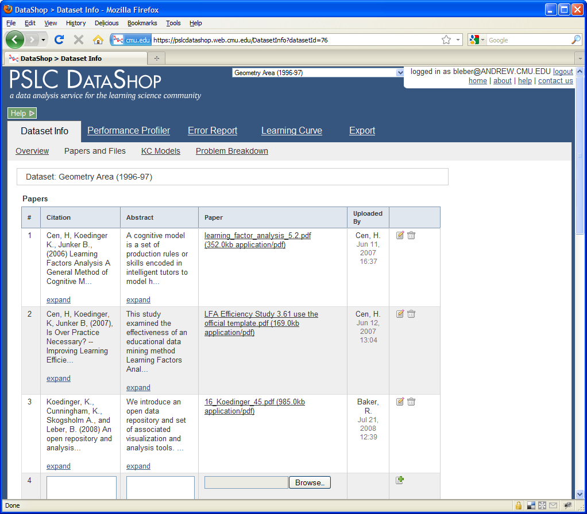

Slide 71
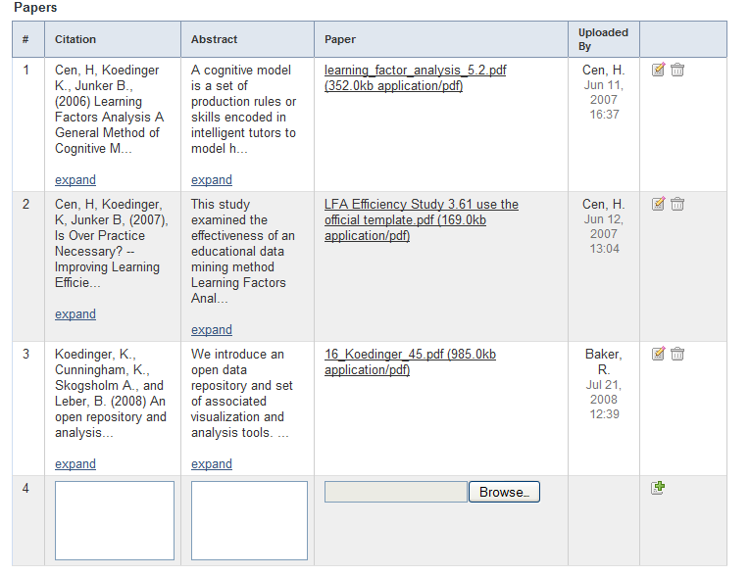
Download file
Attach related papers
PSLC DataShop
datashop-help@lists.andrew.cmu.edu
pslcdatashop.org

Slide 72
KC Models
The Tools
PSLC DataShop
datashop-help@lists.andrew.cmu.edu
pslcdatashop.org

Slide 73
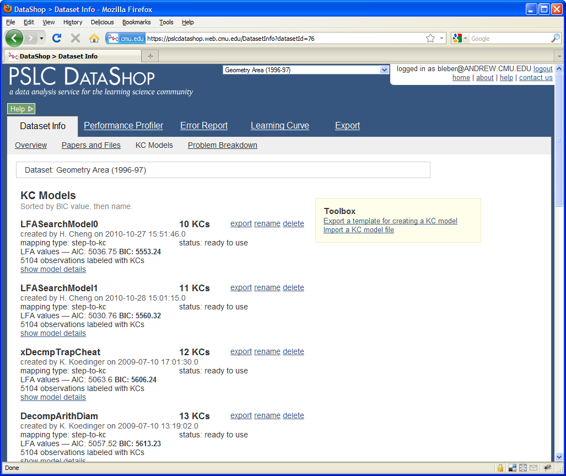

Slide 74
Compare the BIC values across models
Click on these links to export and Import KC Models
PSLC DataShop
datashop-help@lists.andrew.cmu.edu
pslcdatashop.org

